Slide 1
Flood Monitoring for South Carolina Bridges
Beatrice Hunt, AECOM
Ellen Newman, AECOM
Thomas Knight, SCDOT
Amy Hearing, SCDOT
August 28, 2024
Notes:
Not at this Conference but instrumental in development of these materials are Tom Knight and Amy Hearing from SCDOT’s HDSO – Hydraulic Design Support Office

Slide 2
Flood Monitoring
Checking flood and scour conditions at a bridge during riverine and tidal events
Thresholds or
Observation
Notes:
Flood Monitoring can be conducted remotely, on-site or both.
FMGM Def: Checking flood and scour conditions during riverine and tidal events. This type of monitoring is occurs when a flood monitoring threshold is reached. Flood monitoring can be conducted onsite or remotely if real time scour monitoring equipment is installed at the bridge (See Section 7.2). Monitoring does not require the same level of structural review as a post flood scour or routine inspection. Any SCDOT employee with flood monitoring training and access to BridgeWatch may carry out flood monitoring.
It entails checking flood and scour conditions during a flood event.
This type of monitoring is triggered during an event by reaching a flood threshold, or by observation. When warranted, Bridge Management Office, the District Bridge Maintenance Engineer, Lead Bridge Inspector, or HDSO can also trigger monitoring to occur. Monitoring does not require the same level of structural review as post-flood scour or routine inspections.

Slide 3
Collaboration for the Flood Monitoring Guidance Manual
SCDOT
Real-time Scour Monitoring Program – USGS
Scour Plans of Action:
Template – CDM Smith
Guidance Manual – Ayres
BridgeWatch – USES and ESP
Notes:
SCDOT led this effort under their Metric 18 Bridge Scour Program – HDSO led – districts, maintenance, inspection engineers
Hope that you got to see Tim Lanier, USGS at the 8am session today on the RT Scour Monitoring Program
CDM Smith developed the POA template;
Ayres Associates developed the POA GM
The flood monitoring is done within the BrW a web-based monitoring software application to help predict identify prepare for, manage and document flood events
USES – developed and maintains the system
ESP – worked with SCDOT to develop their data and input it into BrW

Slide 4
Why is Flood Monitoring Required?
Safety
Flood monitoring serves to protect the safety of the traveling public during flood events
Regulatory
NBIS 23 CFR 650 applies to all bridges over water and in floodplains during flood events
All SC bridges over water are considered for Flood Monitoring
Priority is given to NBI Item 113/SNBI B.AP.03 Ratings of scour critical, unknown foundations, or non-designed scour countermeasures
US 176, Courtesy of William Munnerlyn, 2015
Notes:
FM is required first and foremost for the safety of the traveling public
Under SC Metric 18 bridge scour project; SC has 8,000 bridges
FM has been practiced by the Districts during large storm events.
Many of the procedures in the FM GM have been in practice in SC for many years.
Monitoring can be at the bridge and/or remotely, if instrumentation is available to provide information during and after a flood.
This GM provides some new ways and best practices and will help to establish more uniform practices in the Districts across the state.
The photo provided by District 2 shows the failure of the US 176 Bridge during the flood of October 2015.
The US 176 bridge over Cannon's Creek is in Pomaria.
Category 4 Hurricane Joaquin did not make landfall, but combined with a low pressure sytem, resulted in more than 1/3 the average yearly rainfall in 2 days in many areas of SC.
USGS: The presence of an upper atmospheric low-pressure system over the Southeast funneled tropical moisture from Hurricane Joaquin into South Carolina during the period October 1–5, 2015, causing historic rainfall amounts
The US 176 bridge was originally constructed in 1949 and collapsed when the middle interior bents were completely undermined as a result of the flood waters (ACEC-ICE replacement bridge text).

Slide 5
Flood Monitoring Guidance Manual
Topics include:
Alert Processes
Monitoring
Documentation – Flood Monitoring Form
Bridge Closures & Openings
Timing of Monitoring & Scour Inspections
Portable & Fixed Monitoring Devices
Thresholds
Case Studies
Notes:
A SC GM for the implementation of Flood Monitoring
The topics listed include the chapters in the GM.
Compilation of existing practices
Developed new practices where we found gaps
Developed to work in conjunction with SC’s new POAs and BrW application
New tool – FM Form
The development of this GM included discussions on their FM practices with the local DBEs and other state DOTs.
Gaps in the FM were identified and the team developed practices, which include adaptive management, to provide guidance for FM.
A PDF of the electronic guide to the Manual will be available (or may be downloaded) from the SCDOT Bridge Scour homepage:
Hydraulic Design Studies (scdot.org)

Slide 6
Define Thresholds
Threshold exceeded, begin FM
Monitoring is triggered when a flood monitoring threshold is reached or by observation
Thresholds: The level of a parameter that must be exceeded for a BridgeWatch alert to be sent out and to start flood monitoring
Thresholds are set in BridgeWatch for bridges in riverine and tidal sites
Types of thresholds
Rainfall
Flow
Tidal Surge
Water Surface Elevations
Flow (cfs)
Time (hours)
Notes:
Thresholds are what typically initiate FM.
SCDOT has established initial thresholds for most structures.
These may be based on several types of measurements including rainfall intensity, WSELs, flows and storm surge.
Generally higher risk structures have lower thresholds and lower risk have higher thresholds.
These values will get calibrated for the bridge personnel through Adaptive Management which will be discussed in Module 6.
These thresholds may be changed based on new data obtained from flood monitoring and/or inspections, or changes in the watershed.
The initial thresholds may be made higher or lower. Changes to the thresholds is known as Adaptive Management and calibration. These will be discussed briefly in this lesson, and in more detail in Module 6.

Slide 7
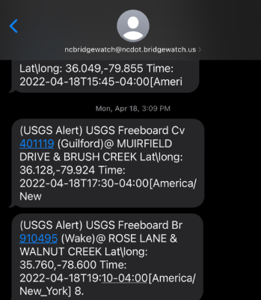
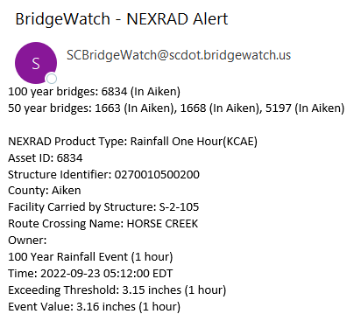
Alerts
When a bridge exceeds a critical threshold, an alert is sent out and it is added to the Watchlist in BridgeWatch
BridgeWatch keeps a record of all alerts, tickets, and other stored data from flood events at a given bridge
Upon receiving a BridgeWatch alert or ticket, the District Bridge Engineer, or their designee, must review data for the site to evaluate the risk and determine the order that the bridge should be visited, and the timing for follow-up visits
Alert notifications distributed by BridgeWatch
Notes:
Event occurs, exceeds threshold, triggers an alert.
BrW notifies subscribed users of structures with alerts, for instance the District Bridge Engineer
Alerts remain active until a user closes the alert (when appropriate actions are taken)
Closing an alert removes a structure from the Watchlist
Tickets are required close alerts.
A ticket provides feedback on the structure integrity, current conditions or threshold that triggered the alert.
Tickets are used to document, maintain and track structure conditions.
Tickets can be added to structures as needed even if an alert is not generated.
More on tickets in Lesson 7D
Right side – update text message example with SCDOT BrW when available
Example notifications of alerts via email and text message.

Slide 8
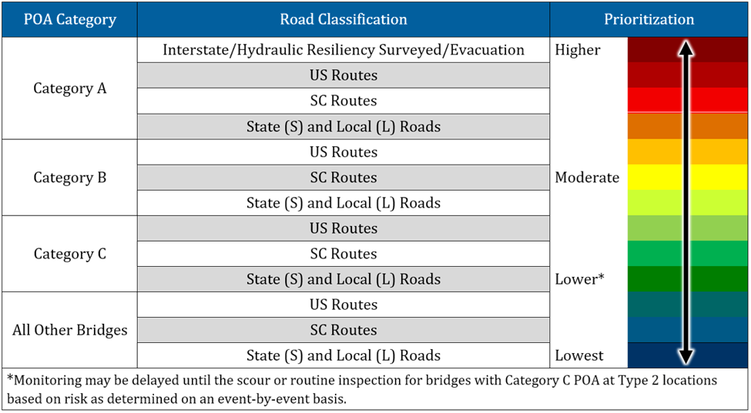
How Risk is Evaluated
The District Bridge Engineer considers:
POA category
NBI/Item 113 coding
Region
Road Type
Size and severity of flood event
Rate of water level rising
Flood history
Average daily traffic
Safety of the traveling pubic
Table 4-6 in the POAGM, Prioritization Ranking. See the FMGM Section 6 for more information. Courtesy of Ayres Associates.
Notes:
Read off the categories for risk. The site characteristics in these categories may influence the decision to prioritize a bridge sooner or later.
As we can see, this chart shows the risks for POA categories in the left column and road type in the following column. POA Category A bridges carrying an interstate/hydraulic resiliency surveyed road or evacuation route are the highest priority. Bridges without a POA carrying a state or local road is lowest in priority compared to the other types. This chart is part of a general guideline, and specific sites and flood conditions should also be considered.

Slide 9
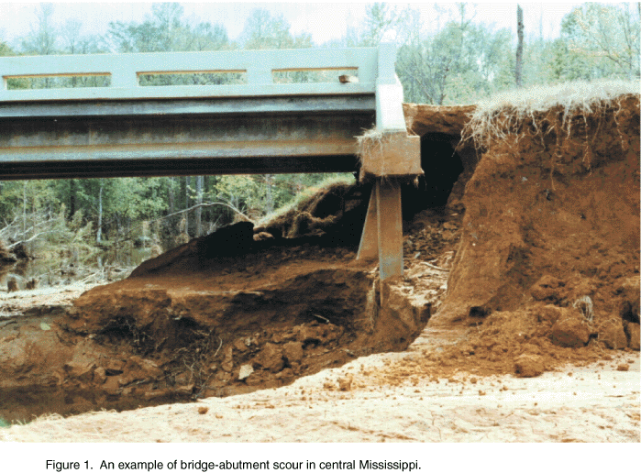
Data from the Bridge File
Maps
Plans
Previous inspections
Scour Assessment
POA (if available)
Critical thresholds
The embankment behind this abutment in central Mississippi has been eroded (Courtesy of USGS)
Notes:
In preparation for a site visit, Review the documents within the bridge file to familiarize yourself with the site you are about to visit. The documents are in BridgeWatch.
The types of documents typically available include maps, plans, prior inspections, a scour assessment, and a Plan of Action. Not every bridge has a Plan of Action. Take note of critical tapedowns, if they are documented within the POA. Reviewing the documents will help you to understand the bridge configuration and any potential scour problems to look for.

Slide 10
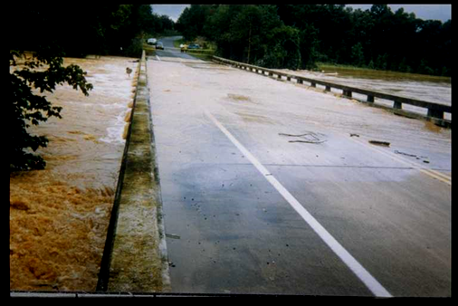
What items are checked during monitoring?
Items to Watch
Pressure flow
Overtopping
High velocity
Water surface elevations
Debris
Erosion
Damage
Maintenance, repair, and scour countermeasure items
A comprehensive list may be found in the Flood Monitoring Form and discussion in the FMGM
USGS stream gage at an overtopped bridge during a flood, USGS Gage 02160390 – Enoree River Near Woodruff, SC (Asset ID 6896; S-30-263) (Courtesy of USGS)
Notes:
Once the DBE has dispatched Monitors, they will examine the site for hazards such as…
The District will decide if a bridge should be closed during overtopping or pressure flow; the other items listed may result in bridge closure. These are discussed in more detail in the following slides.
When something looks not right, make a note of this. Revisit or review to check for ongoing changes.
FMGM Figure 5-2

Slide 11
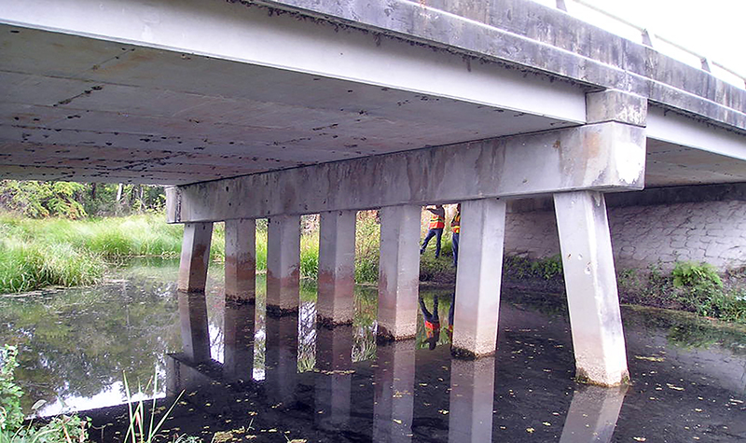
Visual monitoring
Visual monitoring is the process of looking at site conditions and evaluating the effects of the event
Refers to observations of the bridge site for signs of scour, stream instability, and structural distress
Can occur before, during, and/or after a flood
Monitors visiting a bridge, Florida
(Courtesy of Ayres Associates)
Notes:
Visual monitoring is the process of looking at site conditions and evaluating the effects of the event. Monitoring involves observing the bridge for signs of scour, stream instability, or structural distress
Photo source: https://www.ayresassociates.com/project/fdot-district-5-bridge-scour/?r=structural-inspection&sf=Scour%20Evaluations%20%26%20Countermeasures

Slide 12
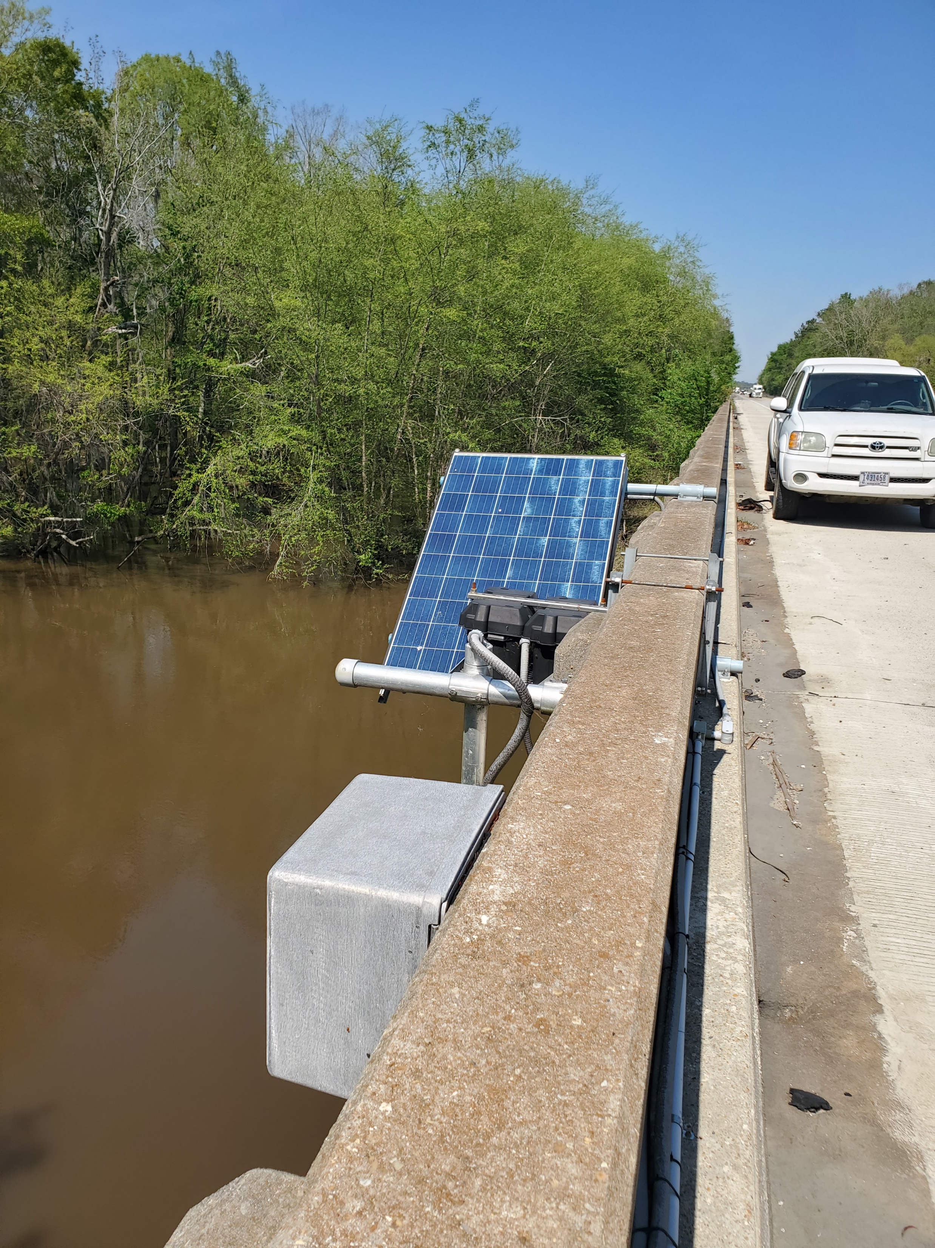
Remote Monitoring
Monitoring may be conducted remotely via fixed instruments
View live data through USGS or BridgeWatch
Visual, portable, and fixed instruments can be used in tandem
Upstream Scour Sensors at I-95 over Lynches River, Olanta, SC (02131510) (Courtesy of USGS)

Slide 13
Fixed Instrumentation
Instruments placed on or near a bridge
These instruments can monitor scour by measuring or observing:
Streambed elevations
Bridge or scour countermeasure movements
Water surface elevations
Flow
Live data is accessed through a database. Data can also be downloaded manually or by telemetry.
Data is currently stored on the USGS website
Notes:
Audience Question: Can anyone give an example of a fixed instrument for bridge scour?
Fixed instruments monitor scour or movement of the bridge
The benefit of fixed instruments is that they capture ongoing, continuous readings.
Last bullet – In the future, users will be able to view the live data on BrW
Future enhancements to BrW include storing and viewing of data functions.

Slide 14
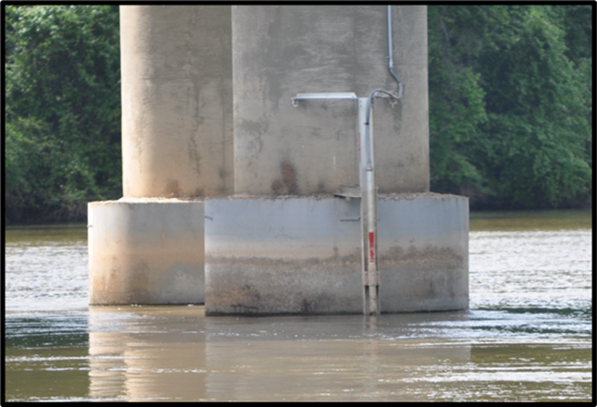
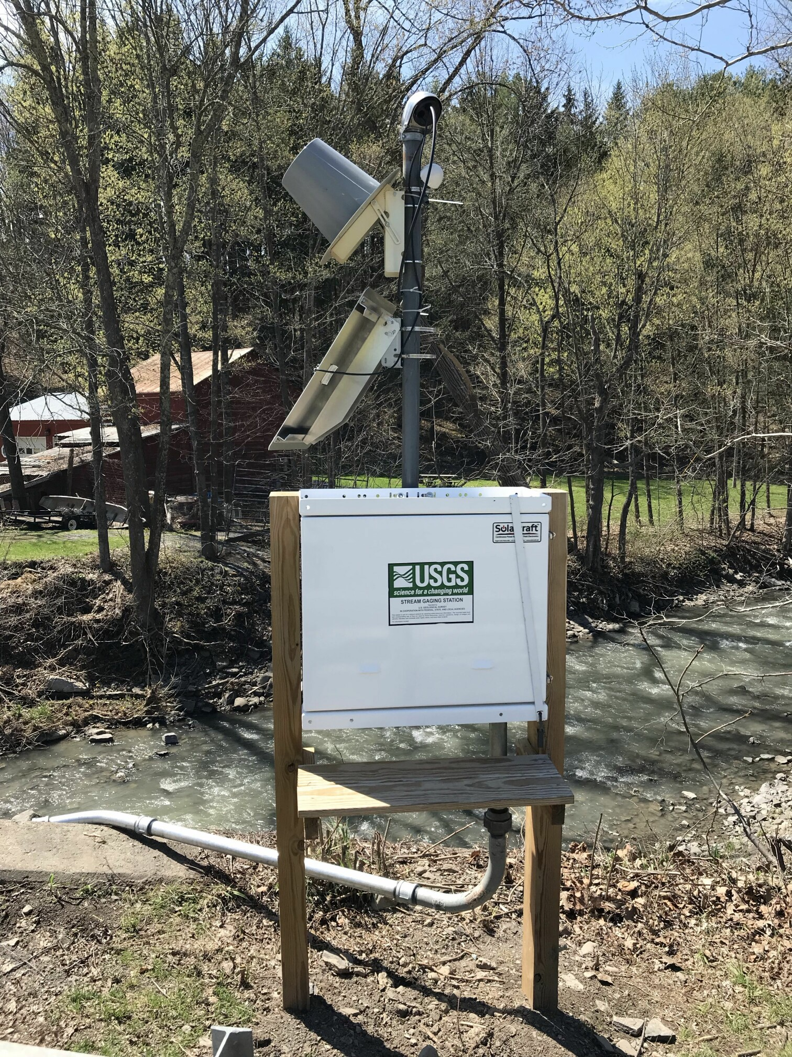
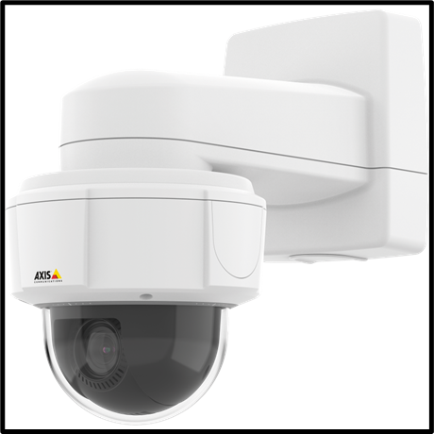
Types of fixed instrumentation used for SC scour monitoring
River cam
Sonar
Stream Gage
Notes:
The types of fixed instrumentation currently used in SC include the sonar devices to measure streambed elevations, stream gages to measure water elevations and river cams take videos of the bridge and may be used to look for movement, water level and distress at the bridge.
These instruments will be discussed in more detail during this lesson.
Stream Gage: https://ny.water.usgs.gov/images/StationPictures/01350480.jpg

Slide 15
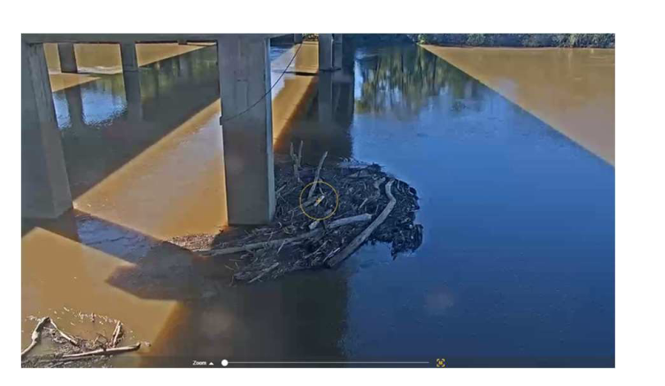
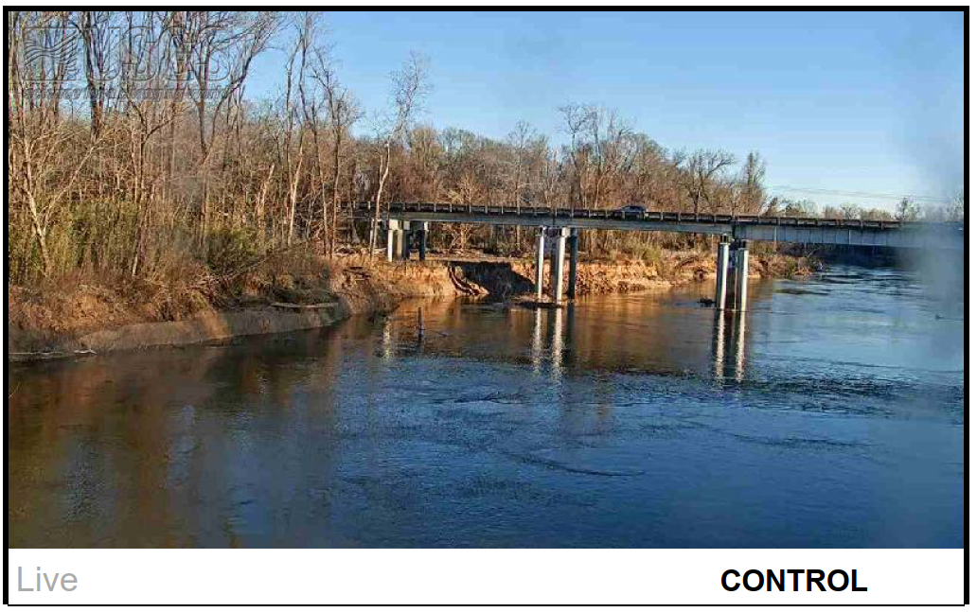
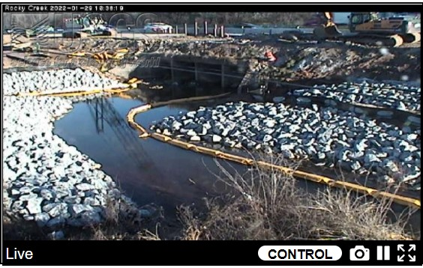
River cam views
Notes:
200 ft shift in bank – OB pier now in main channel
Debris accumulation at pier – maintenance to remove

Slide 16
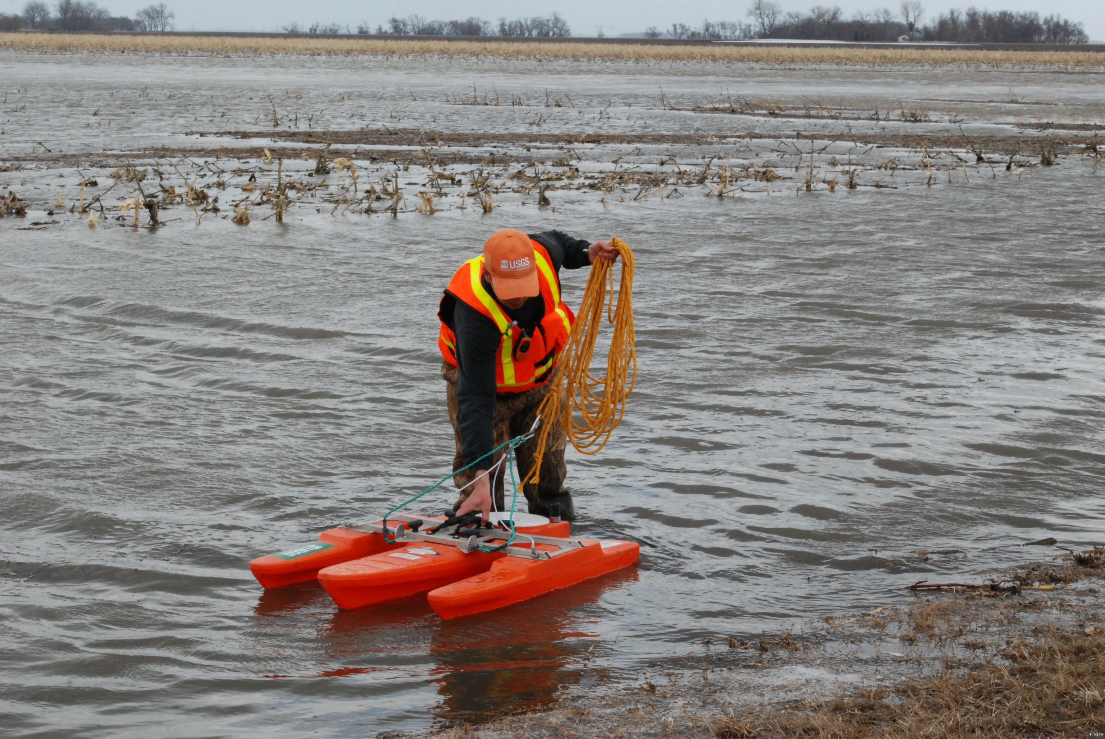
Portable Instrumentation
A tool or device not fixed on the bridge
Devices that provide readings at key locations at a specific point in time
They require a monitor to operate the device and control its movement
USGS Scientist preparing an Acoustic Doppler Current Profiler in Mapleton, ND (Courtesy of USGS)
Notes:
Portable instruments are devices that can be transported to and from a site. Because they are not permanent, they are used to provide readings at key locations at specific times. A Monitor is required to operate the device. Here we can see a USGS scientist readying an Acoustic Doppler Current Profiler.

Slide 17
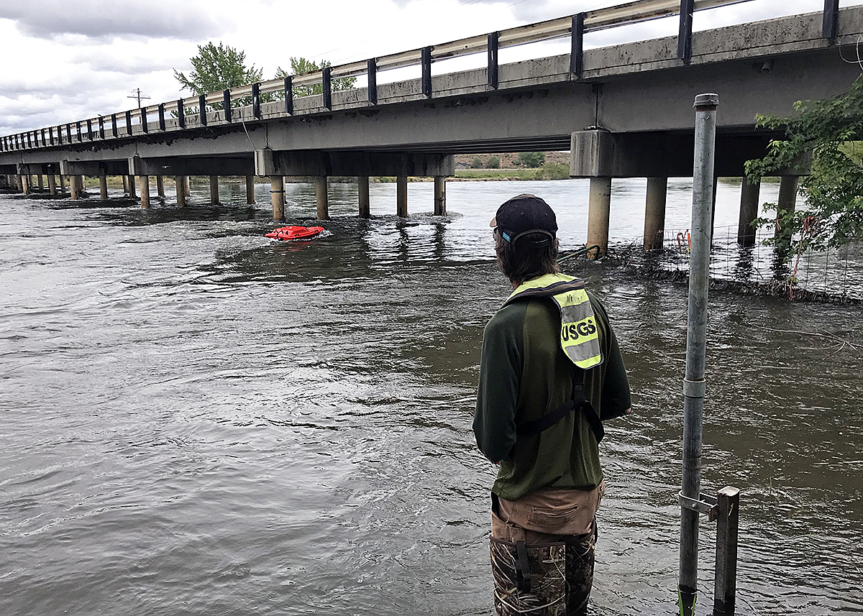
Types of Portable Instruments
Physical Probes
Sounding weights
Extensible rods or poles
Weighted tapes
Sonar Instruments
Fathometers
Fish Finders
Multibeam
Acoustic Doppler Current Profilers (ADCP)
Geophysical Instruments
Ground penetrating radar
Monitor navigates a remote-controlled ADCP to measure streambed elevation at a highway bridge, (Payette River, Idaho)
(Courtesy of USGS)
Notes:
There are three general types, which are physical probes, sonar, or geophysical.
Audience Question: Has anyone ever used a portable instrument before? (then click for bullet points)
Read lists.
Photo: https://www.usgs.gov/media/images/verifying-bridge-scour-sonar-accuracy

Slide 18
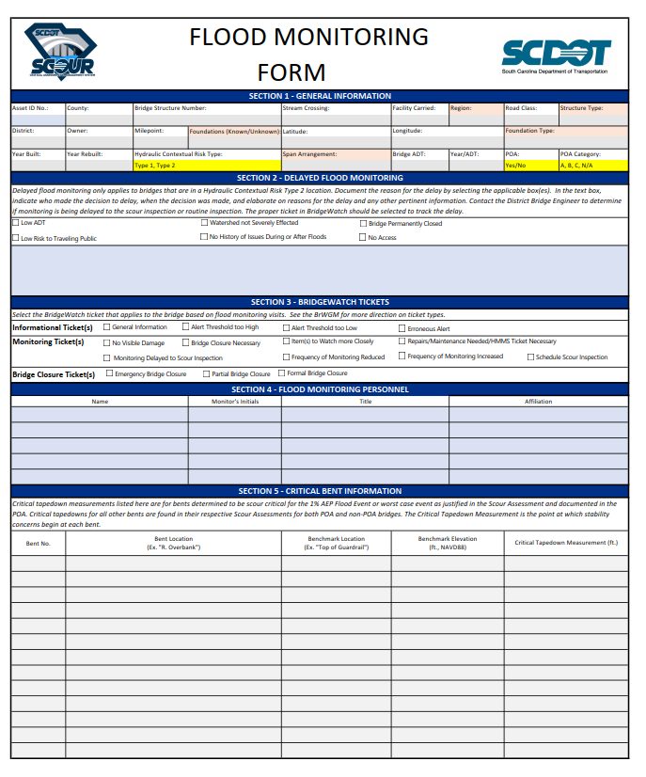
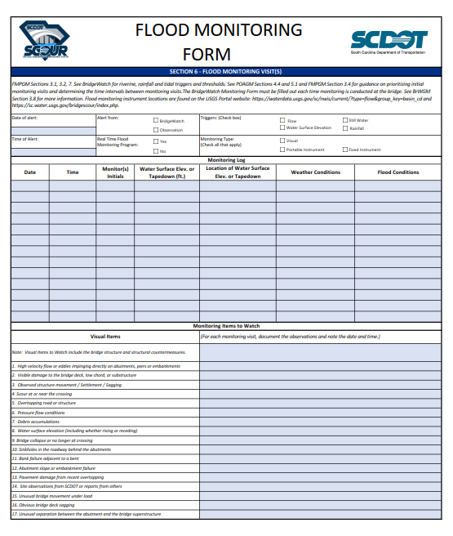
Documentation for Flood Monitoring Forms
Notes:
There is a form developed in the FMGM for Monitoring Personnel to document their visit. There are three types of Items to Watch are listed in the FM Form. The form can be printed, or preferably filled out electronically in BrW. The form is submitted in BrW.
Visual Items, Hydraulic Countermeasure Items and Instrumental Items. All of the items to watch shown on the FM form are in the FMGM.

Slide 19
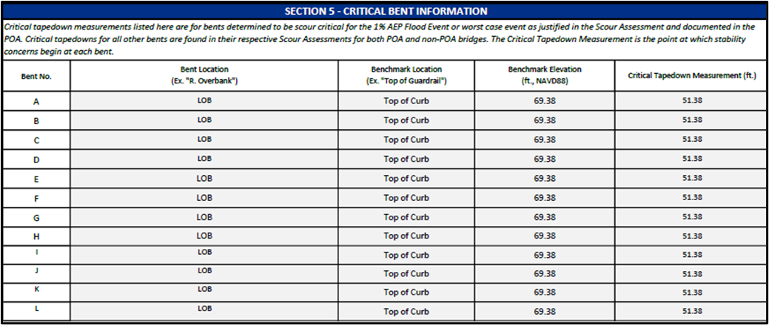
Flood Monitoring Form Sections
General Information
Delayed Flood Monitoring
BridgeWatch Tickets
Flood Monitoring Personnel
Critical Bent Information
Notes:
The first five sections of the form are…. Here we can see a close up of Sections 1 and 5, which are autopopulated, if the data is available. Section 5 will show critical bents, if they have been developed. The benchmarks indicate that if that measurement is reached, then there could be scour issues.

Slide 20
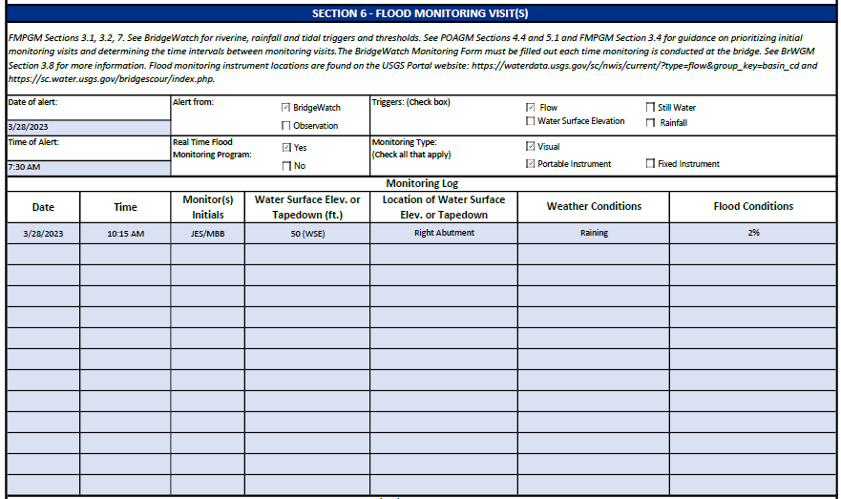
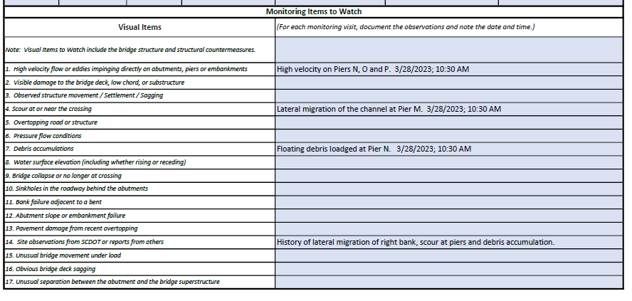
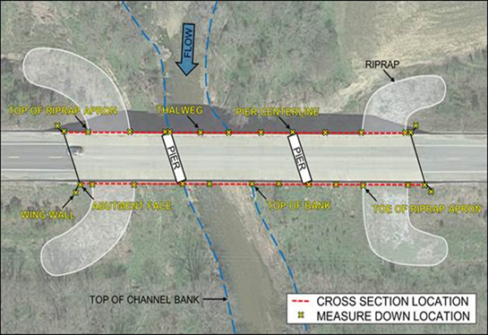
Flood Monitoring Form Sections
Flood Monitoring Visits
Monitoring Log
Monitoring Items to Watch
Tapedown Measurements
Notes:
The Monitoring Log documents what occurred during the site visit, such as the weather, the WSEL (if there is a gage) . There are several rows for repeat visits. The Items to watch are also all listed. Monitoring Personnel will remark if they noticed any of the items to watch. Section 7 is for the Tapedown Measurements. The figure in the bottom right shows where the tapedowns should be taken.

Slide 21
Best Practices for Flood Monitoring
Key elements:
Preparation
Review the FMGM and training modules in advance
Trained personnel, who are familiar with the area if possible
Continuing coordination between the monitors in the field, maintenance personnel, SCDOT engineers, and partnering agencies
Bridge information needed for monitoring and scour inspections (POA, Scour Summary Sheet, etc.) is in a portable format and accessible in the field
Tablet with hotspot or BridgeWatch app offline
If an electronic device is not available, prepare hard copies
Notes:
There are a few key best practices to follow when feasible to conduct Monitoring. Monitors should review the Flood Monitoring Guidance Manual ahead of time. Monitors should be trained to conduct FM. It is helpful if the personnel are local and familiar with the District. Monitors should try to keep in touch with the team and convey the status of the sites they visit. The documentation to record the details of the visit must be accessible, either from an electronic device or printed copies. Printed copies must be returned to your District Bridge Engineer.

Slide 22
Thank you!

Slide 23
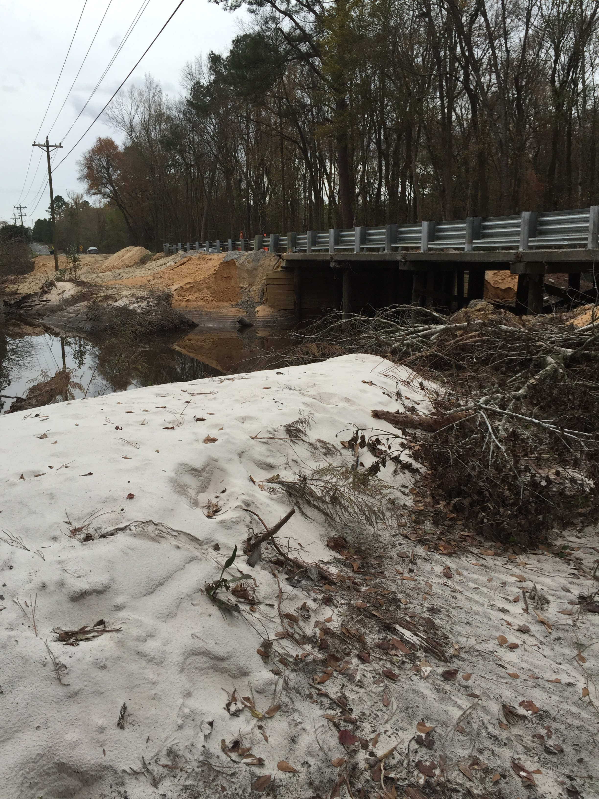
Why is Flood Monitoring Required?
Safety
Flood monitoring serves to protect the safety of the traveling public during flood events
Embankment Erosion at S-28-47
Over Spears Creek (October 2015 Flood)
Notes:
The primary reason for FM is to ensure the safety of the traveling public.
If the monitoring personnel observe distress at a structure, it is a high priority and they will report it for immediate or future actions.
The condition of the bridge is observed to assess whether it is safely passable.
If a failure of the bridge has occurred or is imminent, the personnel will close the bridge and traffic will be diverted to the detour route.
(FMGM Figure 9-7)

Slide 24
Flood Monitoring
Monitoring is triggered when a flood monitoring threshold is reached or by observation
Monitoring does not require the same level of structural review as a routine inspection
Types of Monitoring
Visual, Fixed instruments, Portable instruments
Notes:
Flood Monitoring can be conducted remotely, on-site or both.
FMGM Def: Checking flood and scour conditions during riverine and tidal events. This type of monitoring is occurs when a flood monitoring threshold is reached. Flood monitoring can be conducted onsite or remotely if real time scour monitoring equipment is installed at the bridge (See Section 7.2). Monitoring does not require the same level of structural review as a post flood scour or routine inspection. Any SCDOT employee with flood monitoring training and access to BridgeWatch may carry out flood monitoring.
It entails checking flood and scour conditions during a flood event.
This type of monitoring is triggered during an event by reaching a flood threshold, or by observation. When warranted, Bridge Management Office, the District Bridge Maintenance Engineer, Lead Bridge Inspector, or HDSO can also trigger monitoring to occur. Monitoring does not require the same level of structural review as post-flood scour or routine inspections.

Slide 25
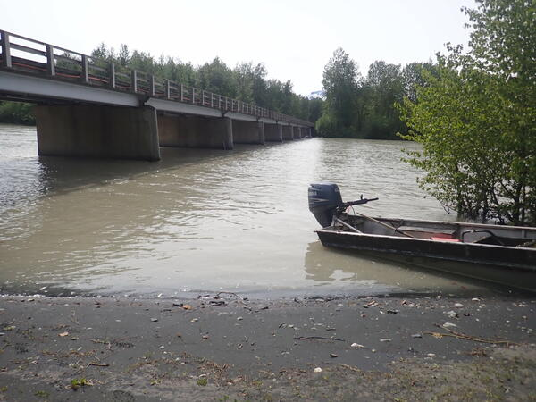
Conducting visual monitoring
Ways to view elements of the bridge and channel
From the deck
From the banks
Using a drone
Camera on a pole
Jon boat or kayak
Off-site if there is a River Cam at the bridge
Consider safety when conducting visual monitoring, and use a River Cam if available to view a location remotely if safety is a concern
If a site is eligible for delay, delay until conditions are safe
A Jon Boat beached at the riverbank at the Chilkat River Bridge in Alaska (Courtesy of USGS)
Notes:
VM can be done remotely if there is a River Cam present at that site, and may be utilized if the site conditions are not safe to physically visit.
Image: https://images.app.goo.gl/PCjtJTKFs2cTRJ4r6, https://www.usgs.gov/centers/alaska-science-center/science/streambed-scour-bridges-alaska#multimedia

Slide 26
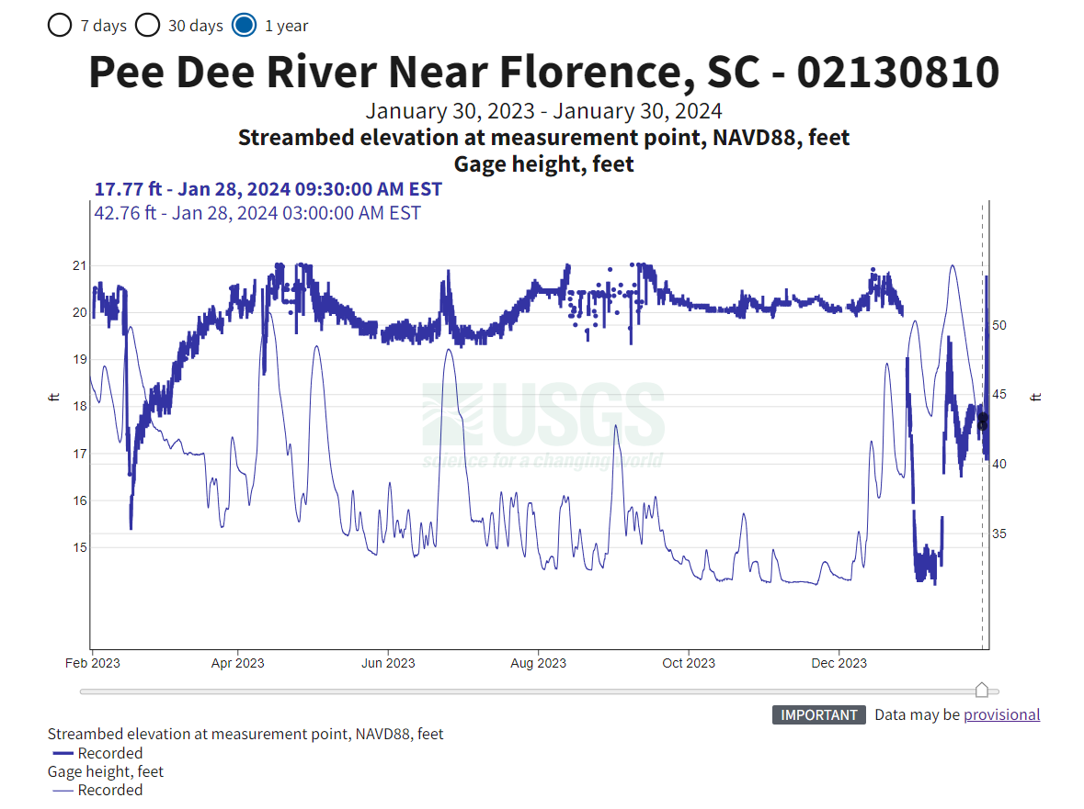
How is the Real Time Scour Monitoring Program Data accessed?
Data may be accessed through several websites:
Regular USGS
USGS-SCDOT Bridge Scour
SC BridgeWatch
Notes:
The RT Scour Monitoring Program may be accessed through several websites. These include the (1) regular USGS website; (2) the USGS Bridge Scour, SC website shown previously in this lesson; and (3) SC BrW.
This graph shows the data post-event for a period of one year.
The streambed elevations are in NAVD88 depicted by the thick line with the elevations in feet on the left side.
The gage height is in feet, depicted by the think line with the elevations shown on the right side.
It can help to observe trends, particularly if the streambed elevation is progressively being lowered.
Discuss the fluctuations and range of the readings.
The data on the websites can be accessed remotely in real time during regular periods, as well as during an event.
This graph shows the data from June 2022 to June 2023 for the gage height and stream bed elevations.
The gage height is shown on the left scale in ft. The readings are the navy blue-yellow thicker line.
The streambed elevations are plotted with the right axis in ft. They are currently shown as Provisional with the thinner line.
Note that the more recent data in yellow is considered Provisional Data as the USGS had not had time to verify it, but it can be used to assess the situation, and follow-up if thresholds are reported.

Slide 27
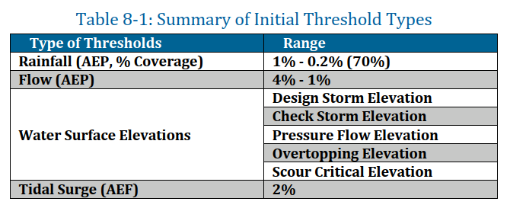
What factors influence the threshold values?
POA Category
A, B, C or non-POA bridge
NBI Item 113 / SNBI B.AP.03 Coding
3, 7, U, 8, 5 /C, D, E, U, A, B
Region
Blue Ridge & Piedmont, Coastal
Flow Type
Riverine, Tidal
Road Classification
Interstate, Evacuation, US Routes, SC Routes, S- Roads, and other publicly owned roads
EVENT AEP or WSEL
FMGM Table 8-1
Notes:
(Note: HDSO plans to update this table for the GM and this presentation.) – This table is from the FMGM of 1-12-2024.
Threshold values are based on a variety of risk factors. These include the POA Category, the NBI Item 113 Coding, the Region where the structure is located, the type of flow and the type of road. These be used to determine an initial thresholds for each structure based on the event AEP or WSEL.
AEP is Annual Exceedance Probability is the probability of an event occurring in any given year. The 1% event corresponds to the 100-year flood, 0.2% is the 500-year, 2% is 50-year and 4% is 25 year.
Rainfall – BrW compiles measurements from several sources NEXRAD, QPE, and QPF, and compared to recurrence intervals statistically analyzed by the NOAA Atlas 14 tool.
Additional information may be found in the FMGM Section 8.1

